Slide 1


FY 2026 Budget
Tri-Board Presentation
February 24, 2025

Slide 2

Budget Approach & Process
Budget Approach
The Town Manager’s Office and Finance Director/Town Accountant have spent the last several weeks reviewing department requests, meeting with departments to better understand their needs, and scrutinizing our revenue projections to ensure we can justify every expense and that we’re confident in our projections for revenue to fund those expenses. This has been a very iterative process that has involved every department at Town Hall. Our aim has been to conservatively estimate our revenue to avoid mid-year deficits while also accounting for new growth and new or expanded revenue sources to maximize our funding capacity. This approach has remained consistent in Town and resulted in the Town maintaining a healthy free-cash balance.
Process/Timeline
Departments were asked to submit their requests two weeks early this year by December 10, 2024 and to craft a budget that maintained level-service and that sought creative approaches to delivering the services residents expect. We spent the weeks following December 10 in multiple meetings with departments refining requests, considering their new requests, and collaborating on a proposed budget that works for everyone.

Slide 3
Landscape Surrounding the FY26 Budget Planning Process

Slide 4
FY26 Budget Landscape
Where are we going into the budget planning process? - Expenses
All but one labor contract on the general government side was settled in FY25 meaning that labor costs are pretty well-known.
  Reversal from FY25 where most labor costs were still in the air
School department in the final year of set 2.7% budget increase
Expected higher than normal health insurance increases. Originally budget 10% but recently learned that the increase is close to 17%.
$1M Contribution to the Middle School Debt ($900k from GF and $100k from Lakeview Lease Revenue)

Slide 5
FY26 Budget Landscape
Where are we going into the budget planning process? - Revenue
Some categories are trending very well -- higher than budgeted.
Earnings on investment trending very well - likely to continue into FY26
New growth expected to fall short -- Likely land in the $700k-$800k range
  Large projects aren’t moving forward as quickly (warehouse on Kendall Road and Middlesex)
  Toll Brothers not set to be complete by June 30 2025

Slide 6
Revenues

Slide 7
Revenue Forecast
How do we calculate the revenue forecast?
Collaboration between the Assessors Office, Finance Department, Economic Development, Building Commissioner, and Town Manager’s Office
Look at 5 year trends
Analyze the current FY trend to identify see how the numbers are currently tracking
Incorporate anticipated new growth based off of input from the departments listed above
Consider the factors that play into the various other revenue streams to identify anticipated changes in the coming fiscal year.

Slide 8
Revenue Forecast
FY25 Trending
Positive trending for revenues for fiscal year 2025
  MV Excise trending toward being $350k higher than budgeted
  Licenses & Permits trending $600k higher than budgeted
  Earnings on Investments $400k higher than budgeted
Revenue areas not trending favorably
  Marijuana revenue - The original FY25 budget included a half fiscal year of a second cannabis retailer -- 2nd location is set to open this month so we’ll correct much of that but might fall $25-35k short for FY25
Overall, based on current trends we’re likely to close FY25 revenue nearly $675k higher than budgeted.

Slide 9
Revenue Forecast
Considerations for FY26
Earnings on investment likely to continue to into FY26
Licenses and Permits will continue to trend positively into FY26 but will likely return to normal levels in FY27
Marijuana excise to likely be flat with FY25 budgeted numbers
State aid expected to be stay at same levels as FY25

Slide 10
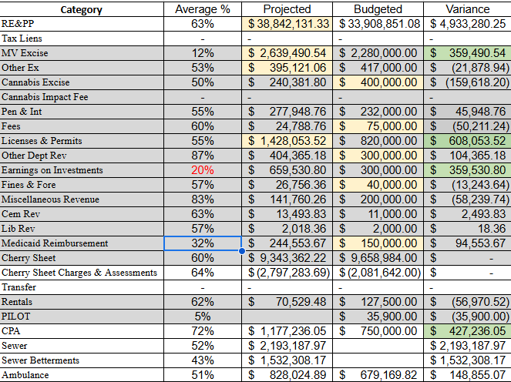
Revenue Trends - FY25

Slide 11
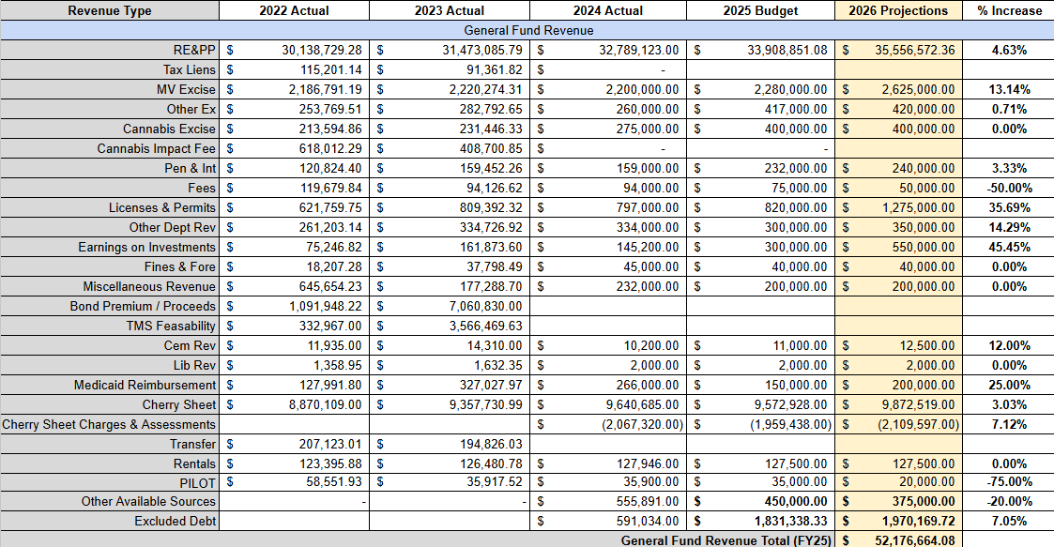
Revenue Forecast

Slide 12
General Fund Expenditures

Slide 13
Expenditures
New Requests in FY26
$900k GF contribution to MS Debt ($100k from Lakeview Lease not shown)
(2) new cruiser leases - Police
Social Media Archiving - IT ($12k)
Patrol Officer - Police ($62k)
Records Clerk - Police ($58k)
Fire Inspector - Fire Department ($72k)

Slide 14
Expenditures
General Fund Budget (Proposed) | $50,131,830
Exempt Debt (outside of Levy) | $1,970,170
GF Revenue | $50,206,495
Exempt Debt Revenue (outside of Levy) | $1,970,170
Total Proposed FY26 Budget | $52,102,000

Slide 15
Expenditures
Administration’s Priority for New Items
Public Safety Administrative Assistant: Split position with 15 hours weekly doing records in the Police Department and 25 hours weekly in the Fire Department as Administrative Assistant
  Estimated FY26 Salary: $51,868
    Already included in Fire Budget ($25,140)
  Net Budget Implication: $26,728 (+potential Health Insurance implication of roughly $20k)
Structural Changes to Budget
Creation of a Facilities Division within DPW resulting in three salaries being moved out of HWY and into Facilities (previously Public Buildings)

Slide 16
Expenditures
Biggest Budget Drivers in FY26
$900k to the Middle School Borrowing
17% increase in Health Insurance Premiums
Items that have yet to shake out but are likely in the right ballpark.
GLTHS Assessment (currently budgeting a 3% increase)
Property Insurance (replacing a $10-15M Middle School with an $80M one)
Where is there cushion?
Previously budgeted $250k from General Fund for Roads Program. This has been reduced to $100k as of today to absorb the health insurance increase. If necessary, could be further reduced with no impact to current plans for road program.

Slide 17
Roads Program - FY26
Source | Amount
General Fund | $100,000
Chapter 90 | $400,000
Fair Share Amendment | $250,000
Road Stabilization | $800,000
TOTAL | $1,550,000.00
FY26 ROADS PROGRAM
Phase I Preservation (Westford Road): $450,000
Phase II Full-depth Reclamation (Elm, Oak, Pine, Bridget, Lincoln): $650,000
2026 Survey: $25,000
Line Striping: $30,000
FY26 Planned Total: $1,155,000

Slide 18
Expenditures
Exempt Debt- Exempt debt is the debt service payments that are outside of the general fund (think debt exclusion). The debt service for exempt debt is billed to taxpayers on top of the 2.5% tax levy.
In Fy25 there were three items under our exempt debt (THS Roof/Boiler, and Middle School). In Fy26 all of the exempt debt with the exception of the Middle School dropped off.
FY26 Exempt Debt Total: $2.9M
$1,000,000 GF Contribution ($900k from GF, $100k from Lakeview Lease
___________________________________
Total Exempt Debt on Tax Bill: $1.97M (was $1.83M in FY25, average impact $405)
$417 annual impact for average home (assessed at 613k)
NET NEW TAX IMPACT ANNUALLY (on average home): $12.00

Slide 19
Capital Planning
Status of Funding Availability for Capital
With the complete drawdown of ARPA Funds, the only available capital funding comes from Free Cash and Borrowing
October STM approved borrowing of $720k for a new fire engine
Free Cash - No available funds
Borrowing - Ability to absorb an additional $350k in debt for this FY
Approach to FY26 Capital
Refocus on true capital needs and direct non-capital back into the operating budget
Address critical items only
Focus on developing a concrete five-year capital plan with identified funding sources for better planning.

Slide 20
Capital Planning
Fiscal Year 2026 Recommended
$719,000 Fire Engine Replacement - Borrowing - Approved October 24
$187,863 PD Exterior Structural Repairs - Borrowing
  $57,863 Window Replacement
  $110,000 Structural Foundation Repair & Waterproofing
  $20,000 Roof Structure Bracing
$151,000 DPW Backhoe Replacement - Borrowing
Total CIP: $1,058,476
Total for 2025 ATM Consideration: $338,863

Slide 21
Free Cash
Original Free Cash Plan
Used estimate (certification pending) which was substantially higher than actual.
  Due to calculating error in spreadsheet that didn’t take into account FY25 appropriations.
Future Free Cash Notes
Note that while we build that number up, we can expect $250-350k in Free Cash moving forward.
  Tighter budget years mean less free cash because you don’t have as much wiggle room
Est. Free Cash Available | $ 650,000.00
Planned Appropriations | $ 550,000.00
Free Cash Balance | $ 100,000.00
Use | Amount
Compensated Absence Fund | $ 23,500.00
Special Ed Stabilization | $ 150,000.00
OPEB | $ 52,500.00
Medicare | $ 189,000.00
FD Design | $ 135,000.00

Slide 22
Future Planning
Capital Budget
Working internally and with Bond Counsel to identify a firm five year plan to present to Capital, FinCom, and Select Board outlining our actual expected costs & funding sources for FY26-FY30
Work with departments to identify requests that should be in the operating budget and incorporate that into our operating budget planning.
Operating Budget
Working to develop a five-year forecast not just for revenue but for expenditures (not done since 2017)
  Attending a two-day workshop with DLS to do this
Sitting down with each department to review their current expenditures and identify steps in FY25 to provide greater cushion when we close the books in July.
Early phases of working with School Administration to come to a new three-year agreement relative to annual budget increases for stability & planning purposes.

